Slide 1
Introducing version control using Git, GitHub and Rstudio

Slide 2
Version Control
Searching, Sorting, Merging, Replacing values:
Searching, Sorting, Merging, Replacing values:
These are the helpful algorithm in Data Structure.
Searching, Sorting, Merging, Replacing values:
These are the helpful algorithm in Data Structure.
Help me allot in clearing Internship and Interview

Slide 3
What it refers to?
Save and overwrite
Only have the latest version
Can’t backtrack
Save to new files
Full history
Lots of duplication
No partial backtracking
Data_File_1.txt
Data_File_1.txt
Data_File_2.txt
Data_File_3.txt

Slide 4
Version Control Meaning -1
Store differences to the last version
Version 1
Searching, Sorting, Merging, Replacing values:
Searching, Sorting, Merging, Replacing values:
+ These are the helpful algorithm in Data Structure.
Version 2
Searching, Sorting, Merging, Replacing values:
+These are the helpful algorithm in Data Structure.
+Help me allot in clearing Internship and Interview
Version 3

Slide 5
Version Control Meaning -2
Version 1
Version 2
Version 3
File A
File B
File A*
File A**
File D
File C
File C
File C*

Slide 6
Importance of Version control
Keep track of modifications
Back-up capabilities
Collaboration
Sharing
Repositories

Slide 7
Distributed Repositories - GitHub
GitHub
Main server
Repository
pull
push
pull
push
push
pull
Repository
Repository
Repository
update
update
update
commit
commit
commit
Working copy
Working copy
Working copy
Computer 1
Computer 2
Computer 3

Slide 8
Committing files to a Git repository
Repository
commit
Staging
Area
update
File
add
Working copy

Slide 9
Checking out a previous version
Requires use of the terminal in RStudio
git checkout [revision] .
where [revision] is the commit hash, for example:
git checkout 668c6a44383e7381d0417143da12804f1ae8fb66 .
The . at the end means that all the files will be checked out.
To only checkout one file from a previous version:
git checkout [revision] [file_name]
e.g.
git checkout 668c6a44383e7381d0417143da12804f1ae8fb66 scatterplot.R

Slide 10
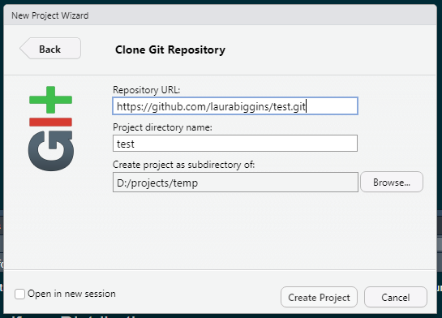
Importing repository from GitHub into RStudio
New project -> Version Control -> Git
Paste in URL from GitHub

Slide 11
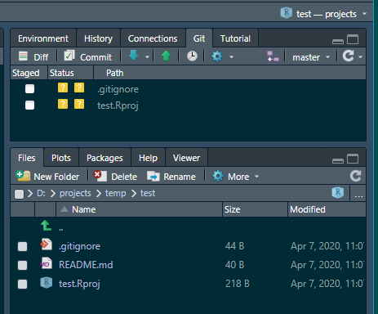
In creating the new Rproject, a test.Rproj file was created, along with a .gitignore file.

Slide 12
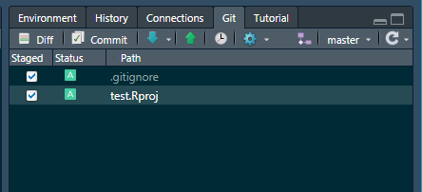
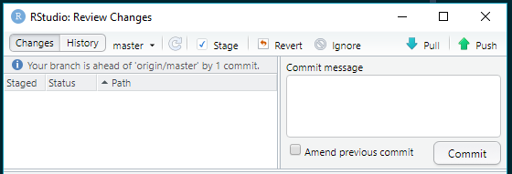
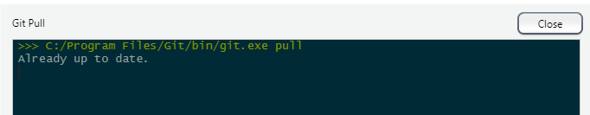
2
To stage the files – select the tick boxes under Staged
Click on Commit
1
Always a good idea to do a Git pull
Should see an information message saying that it’s already up to date

Slide 13
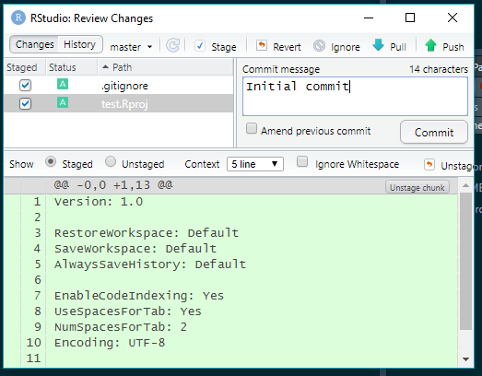
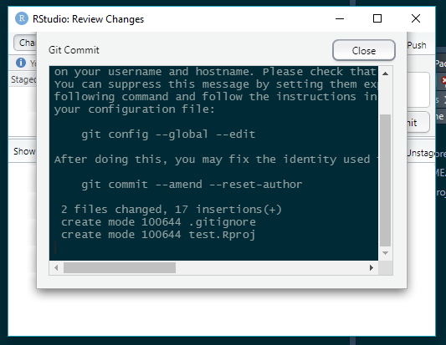
Add a commit message and select commit
Should get confirmation – select Close

Slide 14
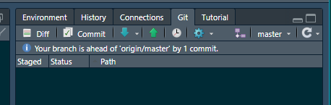
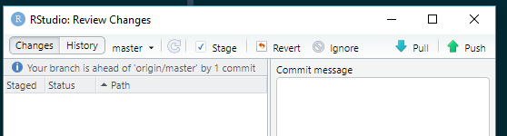
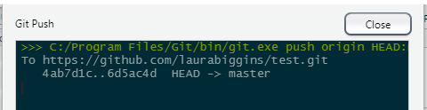
Should see an information message saying your branch is ahead of origin/master by 1 commit.
The changes – the creation of the new files - test.Rproj file and .gitignore, have been committed to the local git repo, but they haven’t been pushed to the remote repository.
The push button can now be clicked
This should then push the changes to the remote repository.

Slide 15
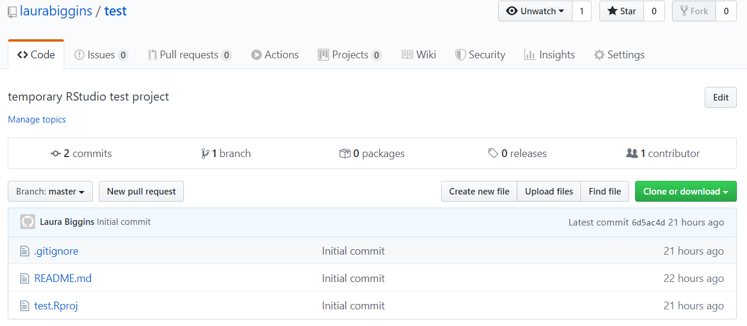
Back to GitHub
This should then push the changes to the remote repository and if the GitHub web page is refreshed, the new files should appear.

Slide 16
Existing R project not in GitHub
Export an R project to GitHub

Slide 17
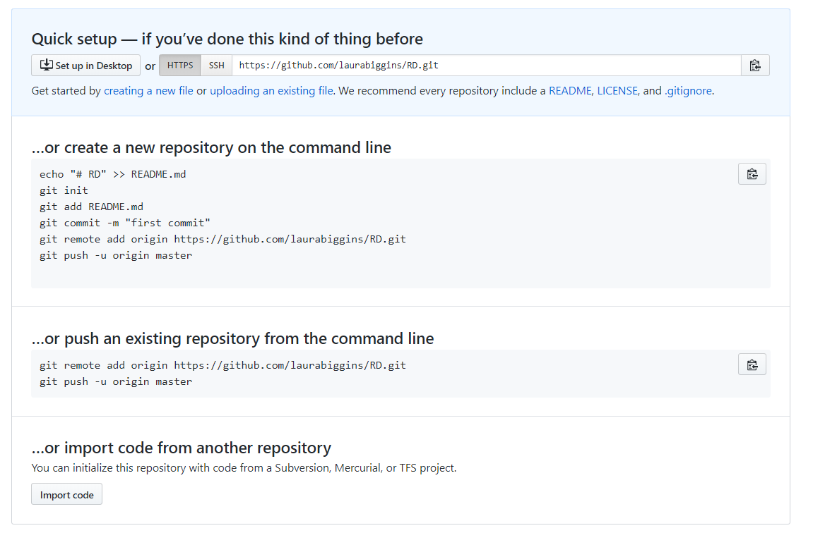
Copy the 2 lines of code

Slide 18
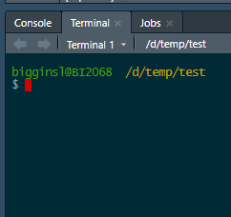
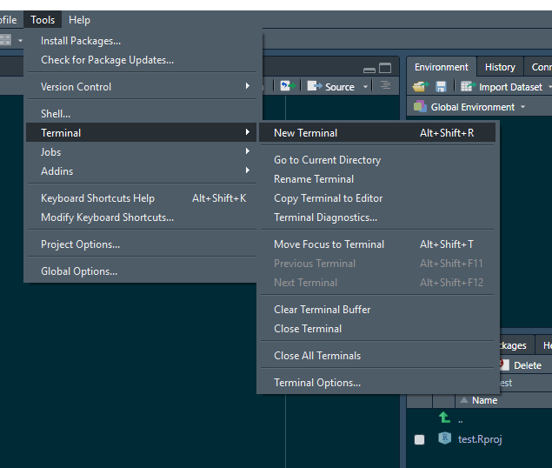
Using the terminal in RStudio

Slide 19
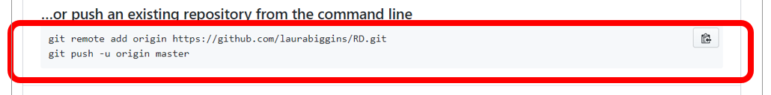
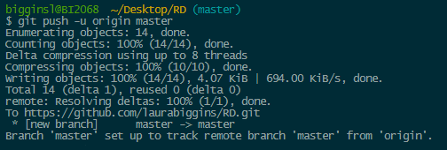
Using the terminal in RStudio

Slide 20
Thanks

